Slide 1
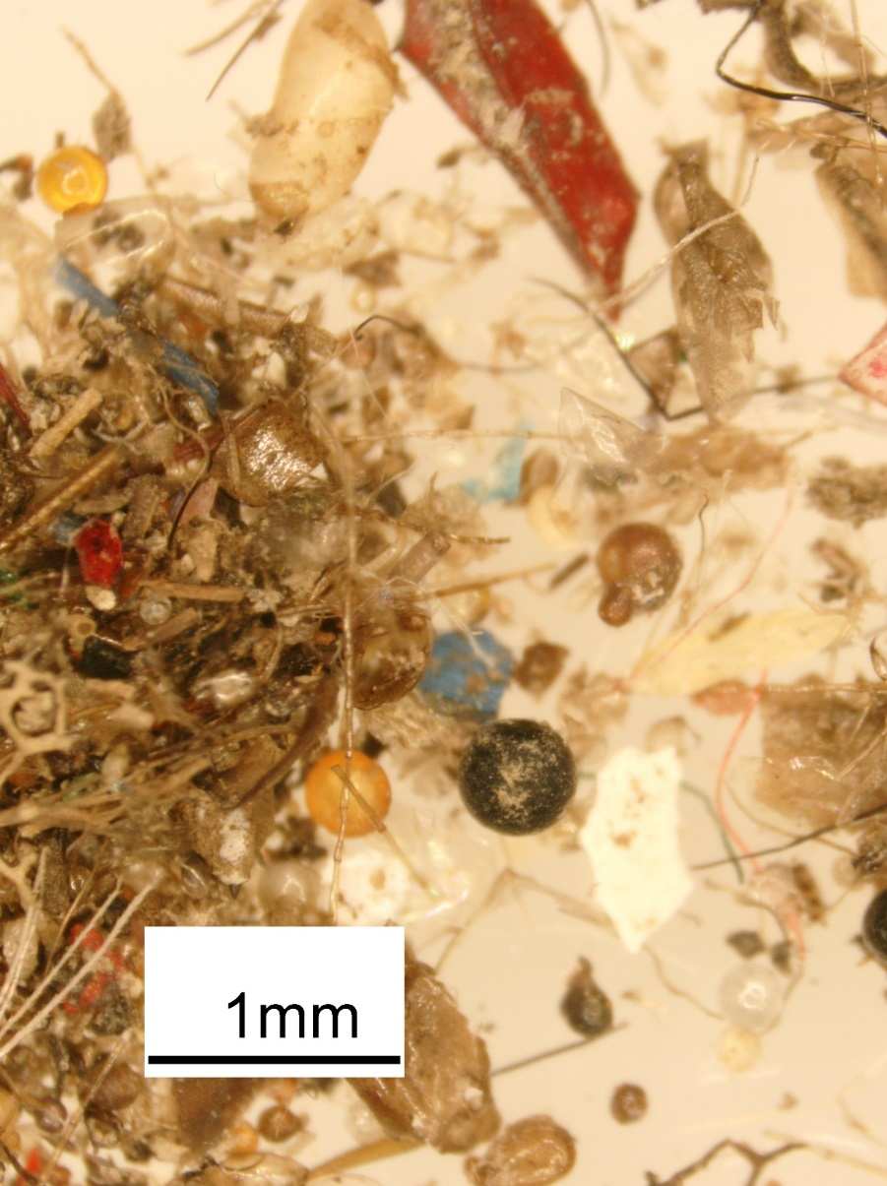
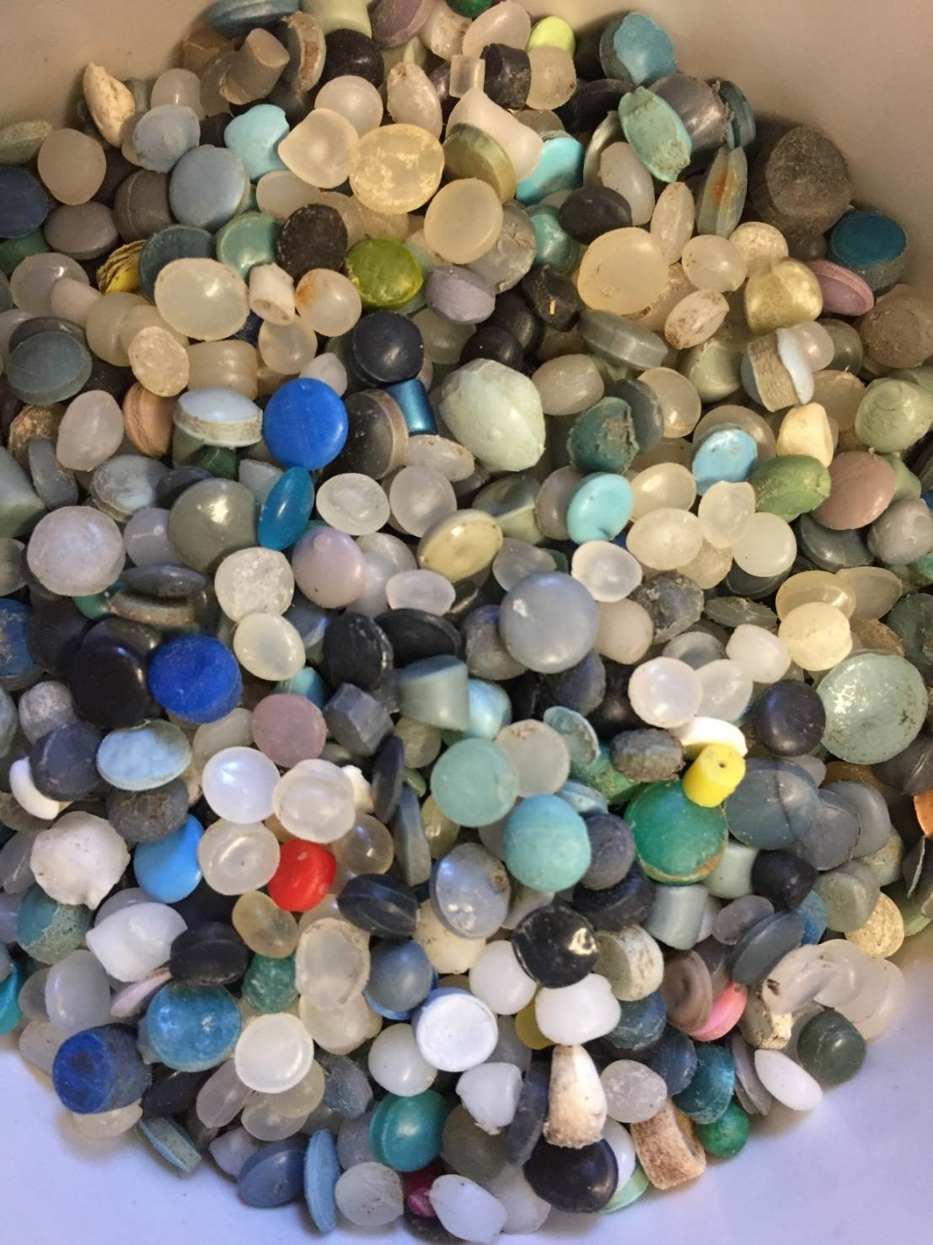
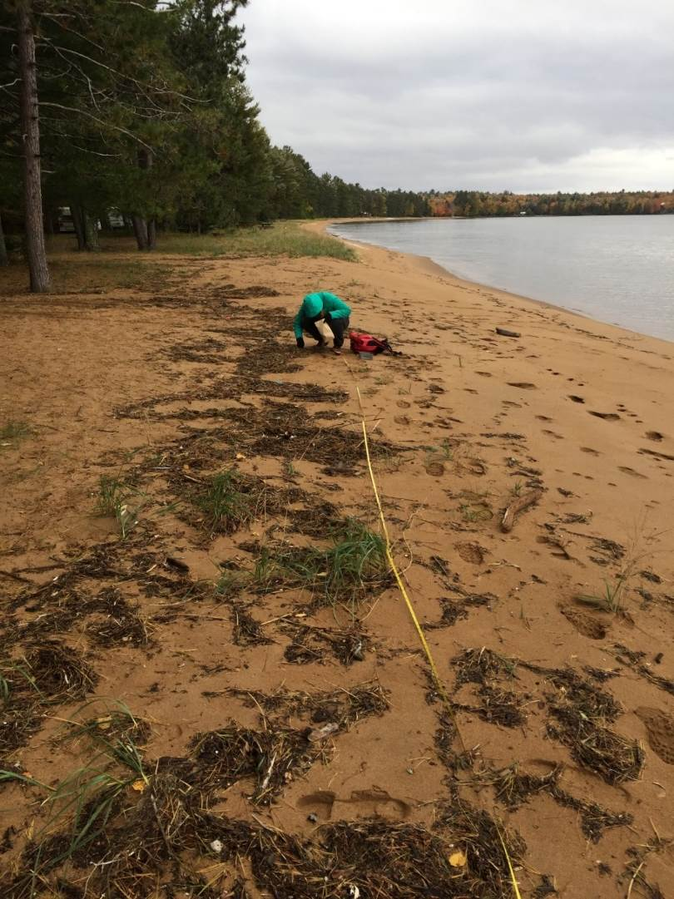
Plastics Pollution in Aquatic Compartments: Controls on Transport, Deposition and Degradation

Slide 2
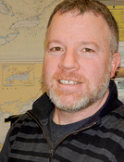
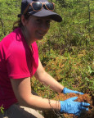
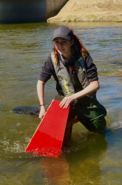
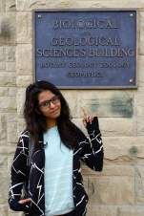
Who Are We?

Slide 3
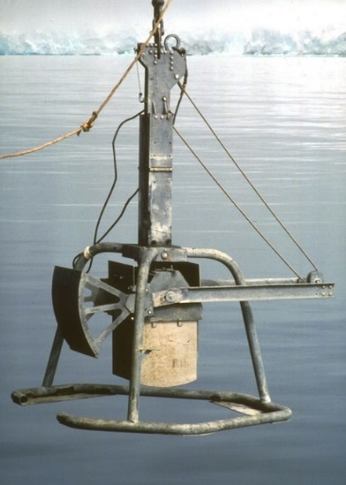
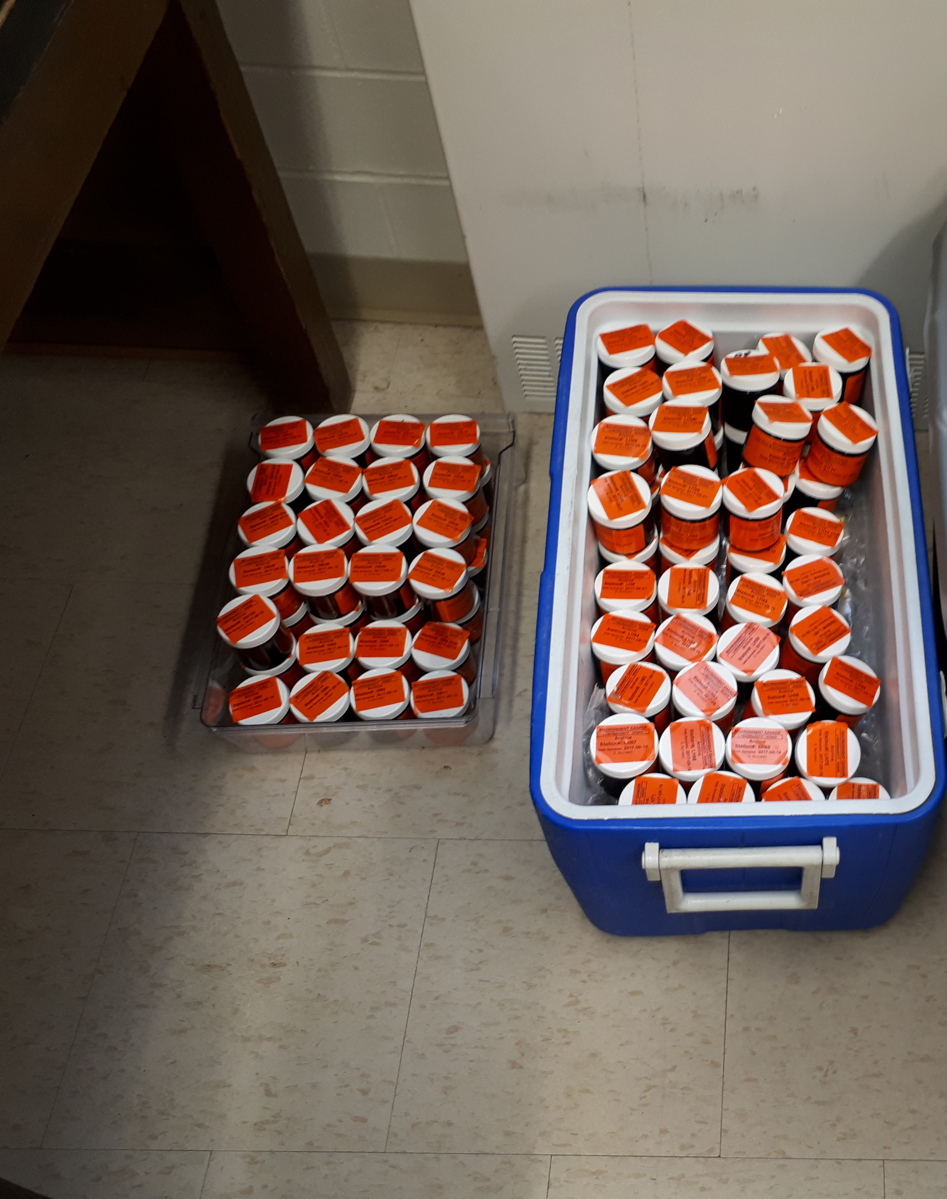
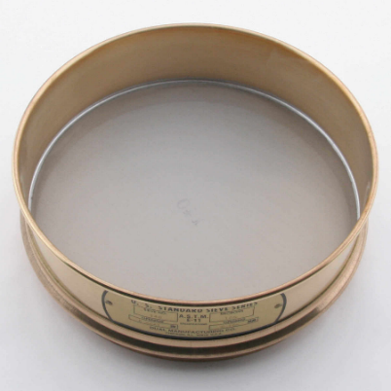
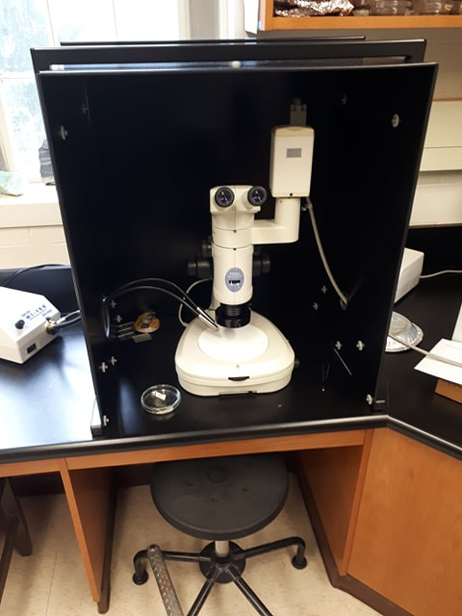
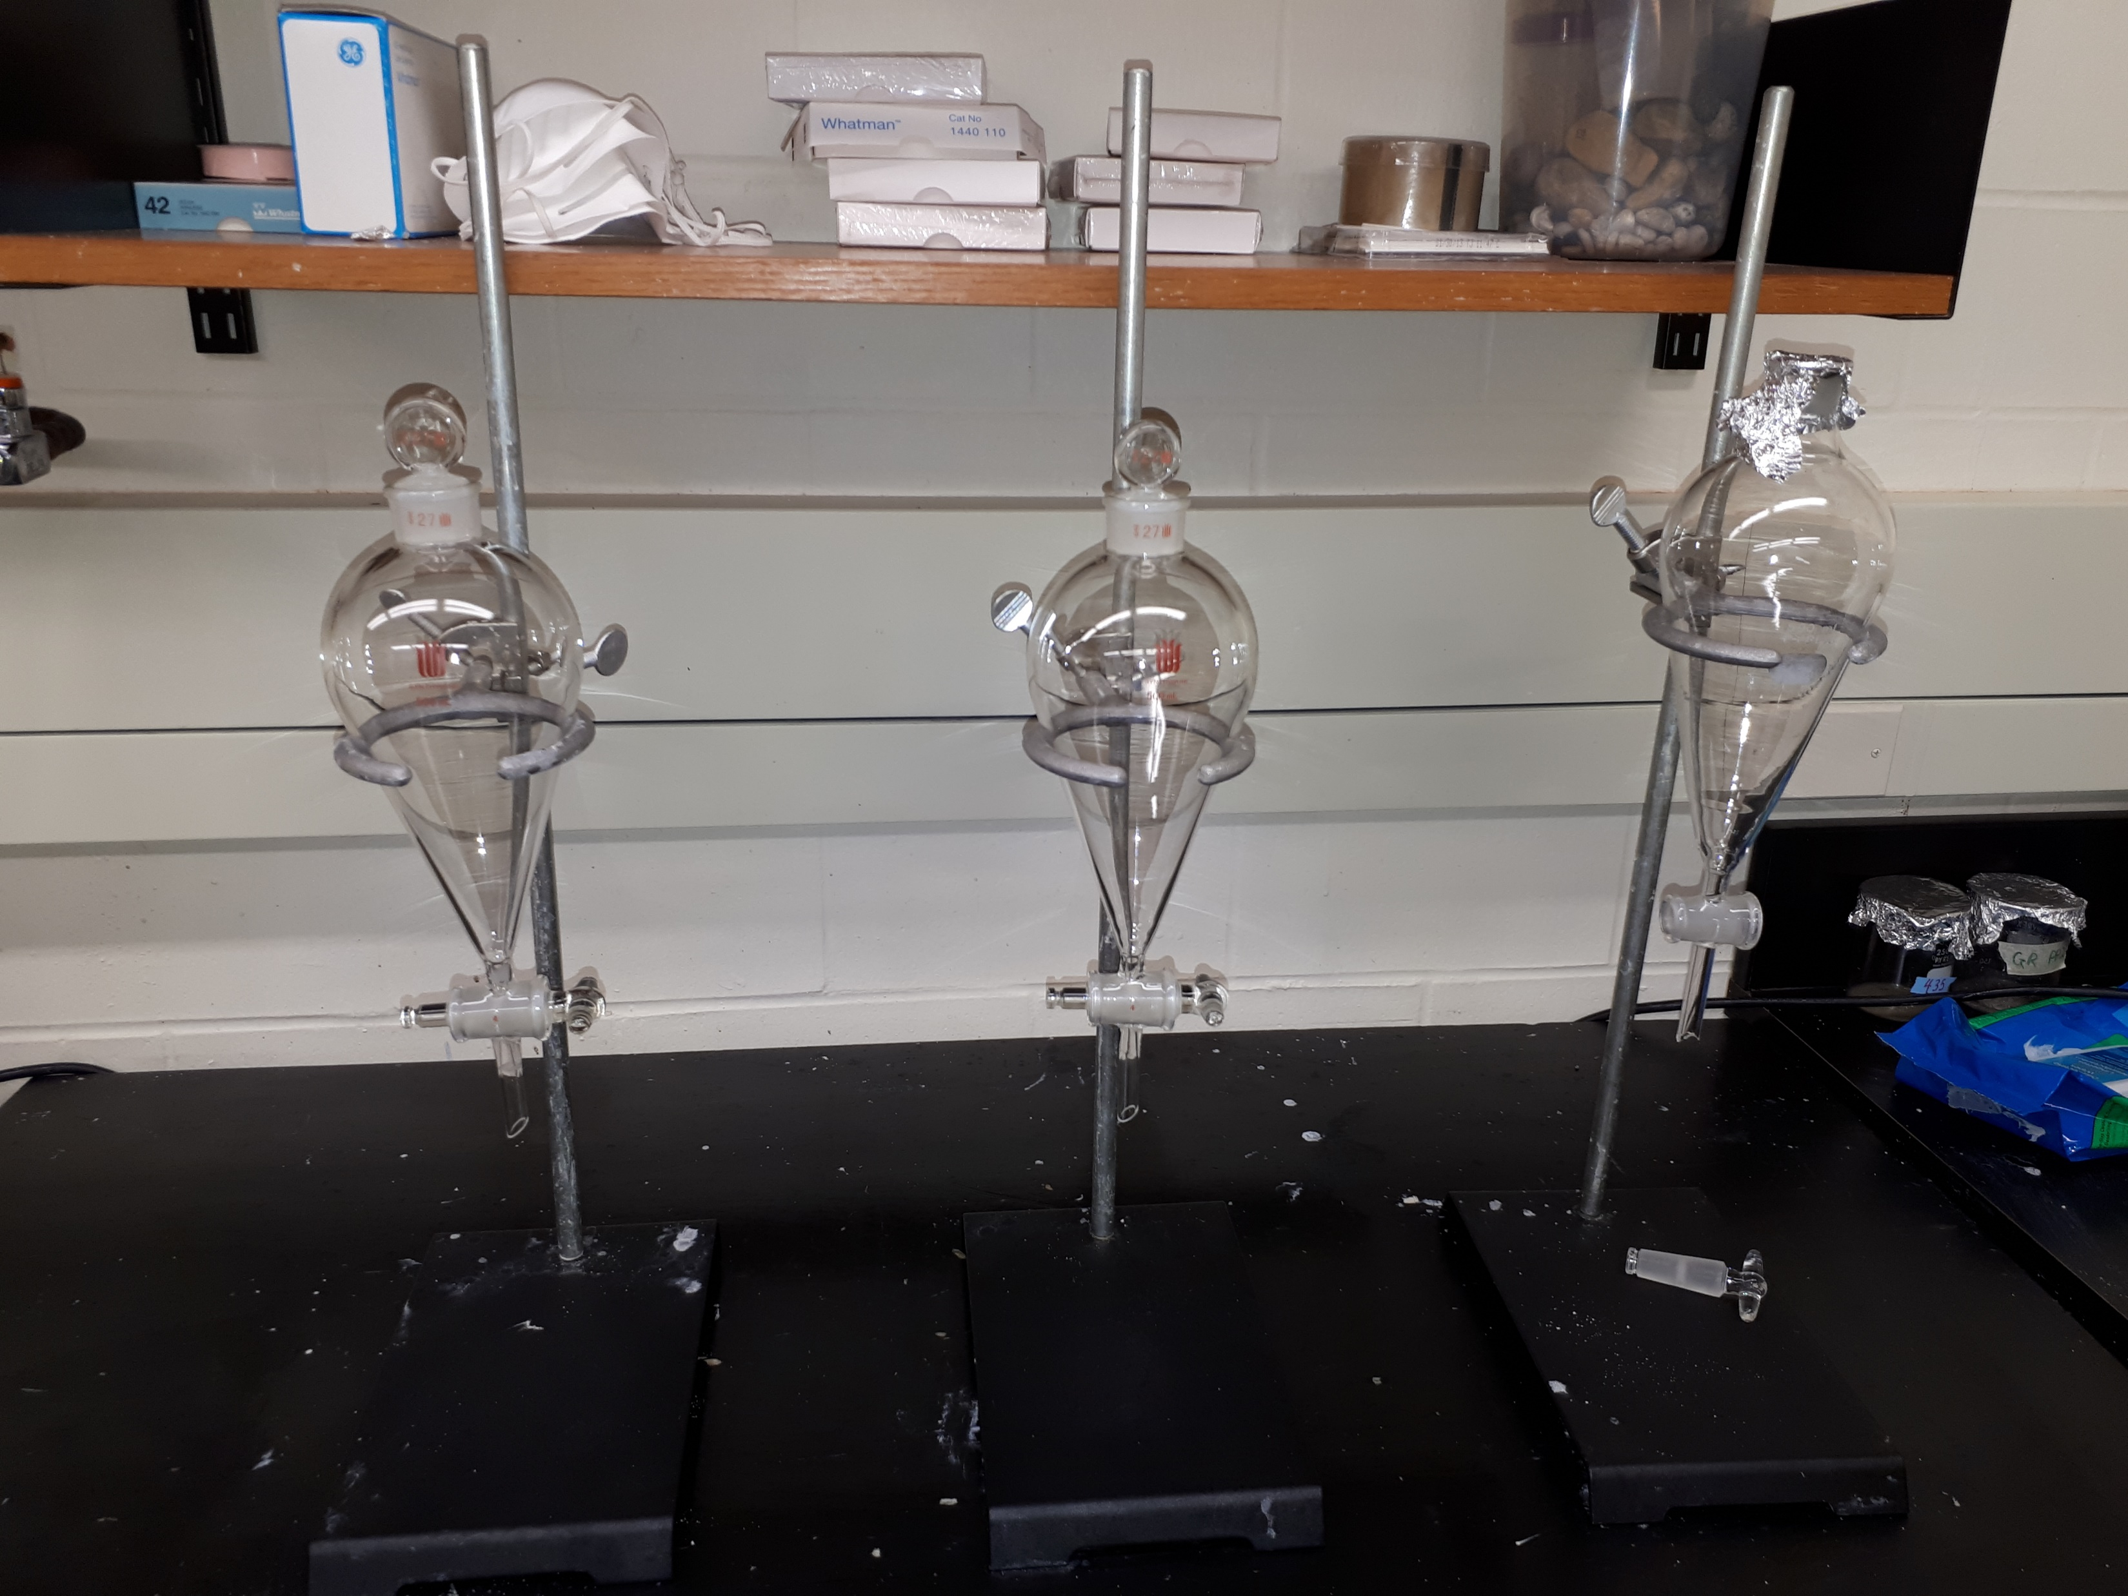
What do we do?

Slide 4
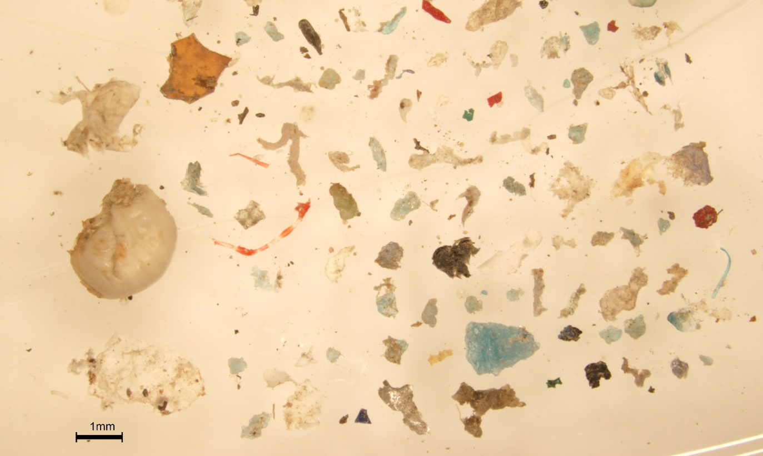
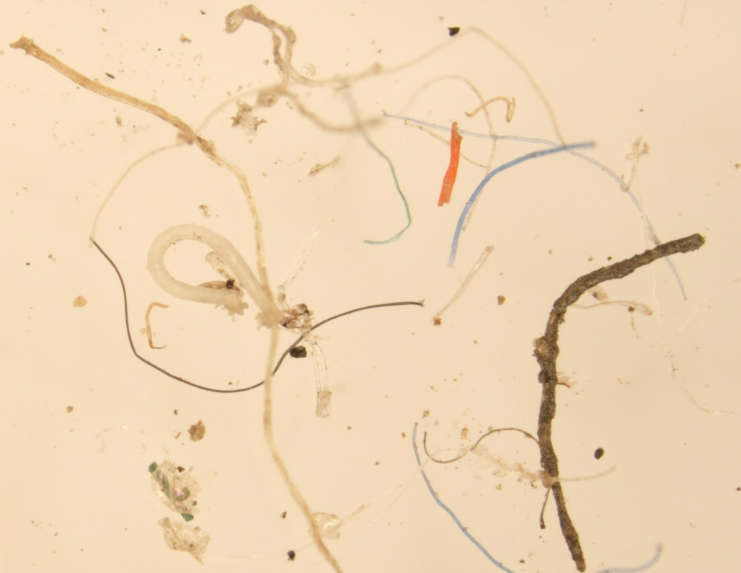
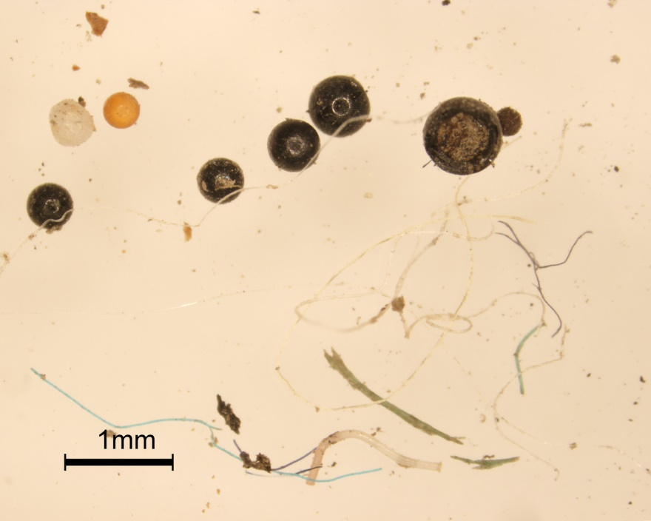
What do we do?

Slide 5
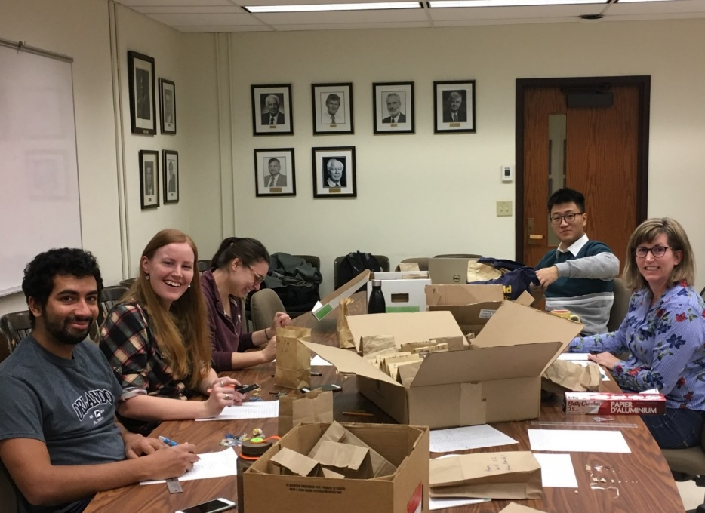
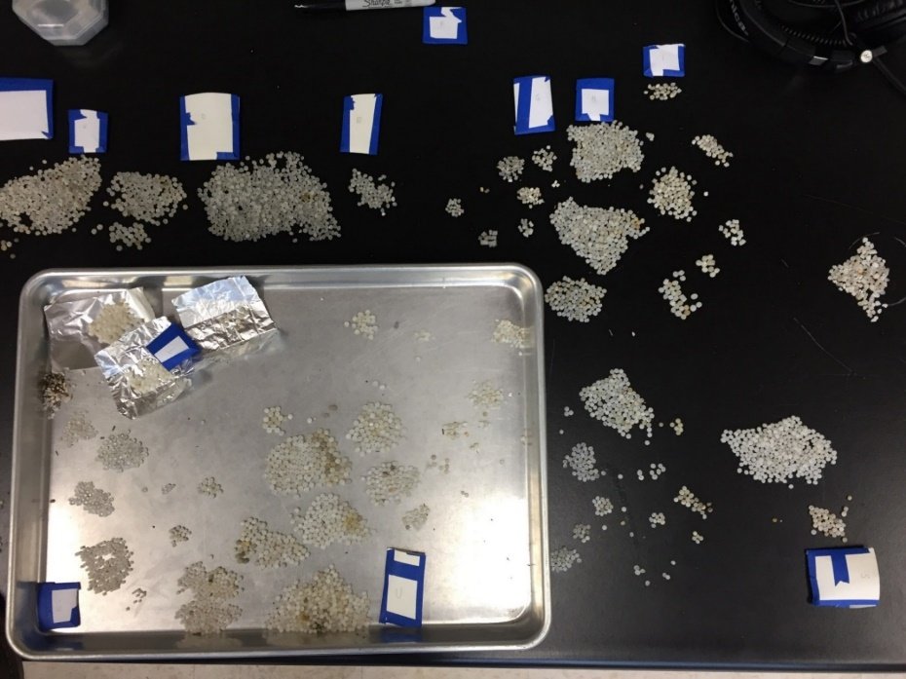
What do we do?

Slide 6
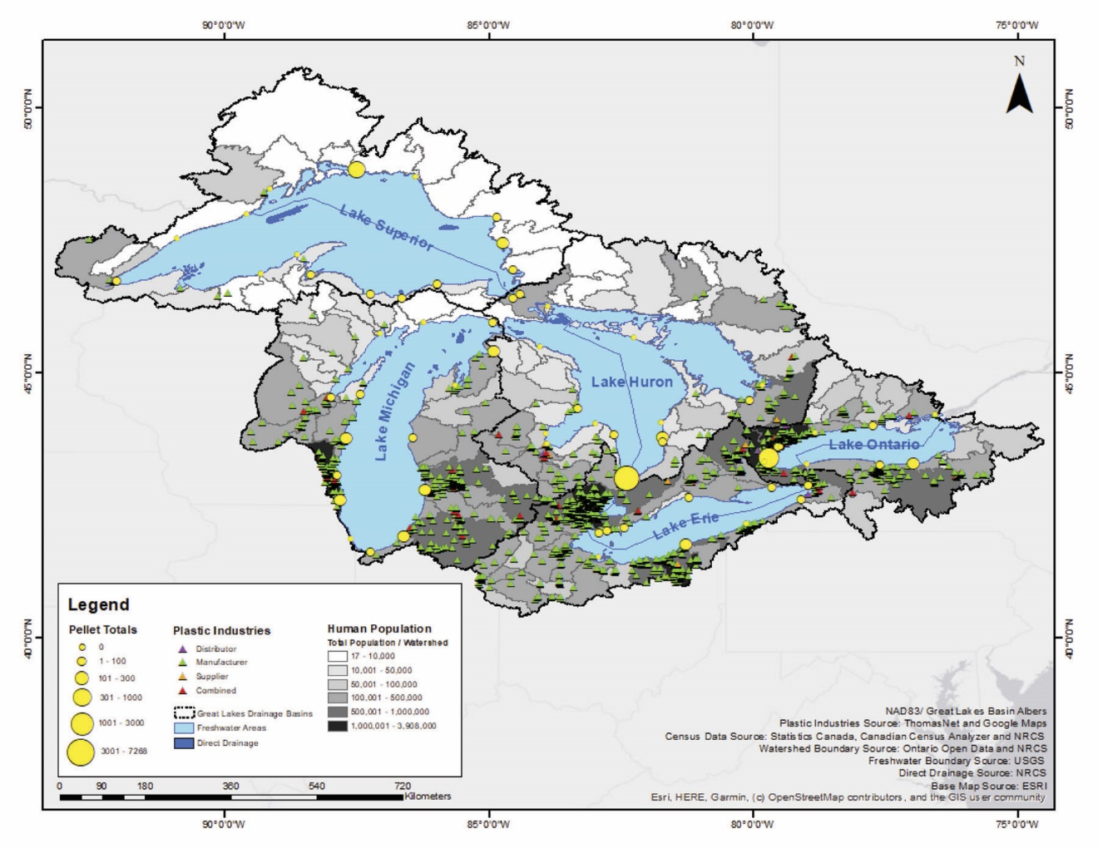
What do we do?

Slide 7
Findings
Example Abundances:
12,595 pellets on Great Lakes beaches; 19 pellets/m² (n=66)
6-2444 particles per kg of dry weight sediment (kg⁻¹ dw) in the Thames River, Ontario (n=34)
20-27,830 kg⁻¹ dw in benthic samples from Lake Ontario and mouths of tributaries (n=50)
Abundance Conclusions:
Abundances are related to proximity to high population areas, high numbers of plastic industries, and tributaries
High abundances associated with large amounts of organic debris and fine grain sizes

Slide 8
Findings
Transport:
Tributaries are major pathways for plastics to reach lakes and oceans
Microplastics in Arctic sediment indicate long-distance atmospheric transport
Low-density plastics sink as a result of four main factors
Composition:
Fragments and fibres are most abundant
PE, PP and PET are the most common polymers
Identifiable sources include tires, paint and other coatings, flashing, glitter…

Slide 9
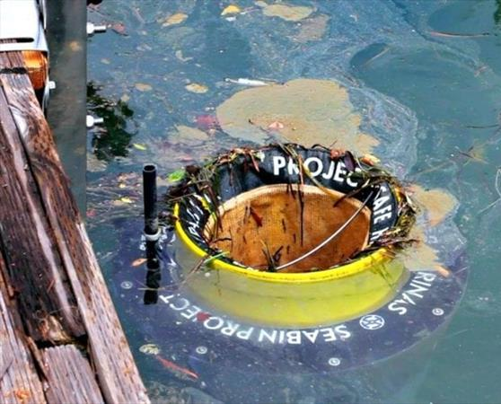
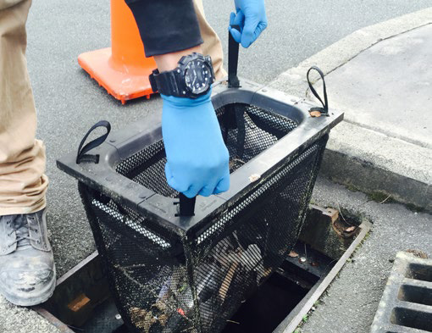
What are we doing?
Seabin Project © Mary Lou
https://www.enviropod.com/products/littatrap

