Slide 2
OUR STORY
After 25 years of hard work and innovation, trailblazing and advocating, Ice River not only stands for the highest quality, environmentally responsible water available – it is also a name that has become synonymous with forward-thinking leadership throughout the industry.
In 2007, Ice River Springs set out to lead the bottled water industry into unchartered territory in search of a more sustainable packaging option. Through the process of elimination, we determined that recycled PET was by far the best material available for food & beverage packaging. Though many believed it to be impossible, we have built a recognized and well-established circular economy for PET in Ontario. We believe in the stability of this circular economy so much that we no longer purchase virgin PET and manufacture our bottles from 100% post-consumer recycled content.
We operate our own recycling facility in a closed loop: from The Blue Box (curbside collection) to recycled bottle manufacturing, to fresh natural spring water products…and back again.
Ice River is a family-owned Canadian company whose very name tells a compelling story – how a source of unbelievably pure natural spring water inspired passion and commitment, a lesson for all to hear…when you have a precious resource, you do everything in your power to protect it.

Slide 3
OUR HISTORY
Family owned and operated Canadian company founded in 1995
Opened our first facility in Western Canada in 2004
Received CFIA Letter of Non-Objection for the first ever 100% rPET bottle in 2009
Opened BMP Recycling Facility in 2010 to produce our own food grade resin
Introduced first “Blue Box Closed Loop” 100% recycled content bottle in 2010
Initiated 100% rPET Green Bottle in 2014
Invested in Greenlid in 2016
Welcomed C.R. Plastic Products to our family of companies in 2016
After 3 years of hard work, achieved zero waste to landfill at all bottling facilities in 2017
Opened BMP Extrusion Facility in 2018 to integrate film production and recycling
Introduced 20% recycled content case wrap in 2019

Slide 4
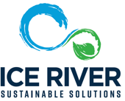
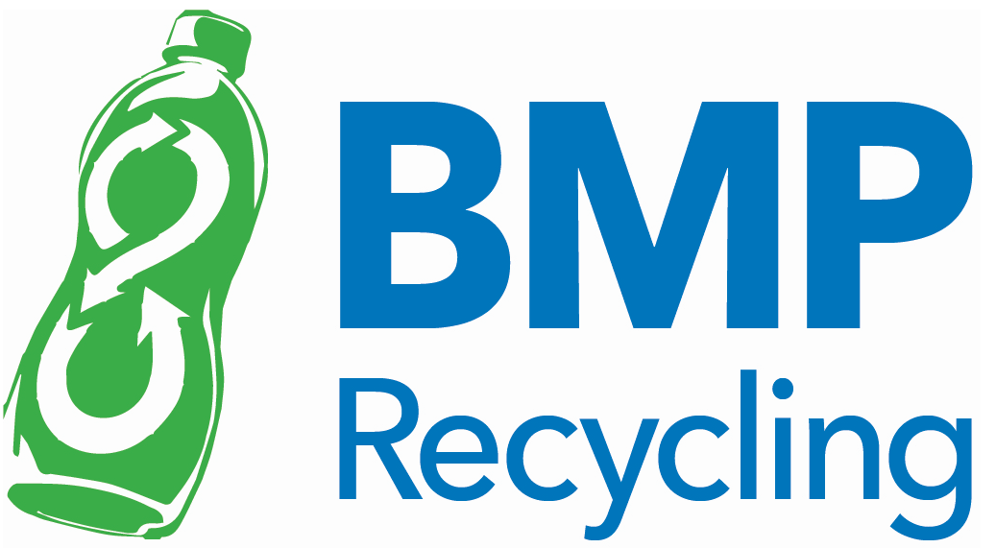
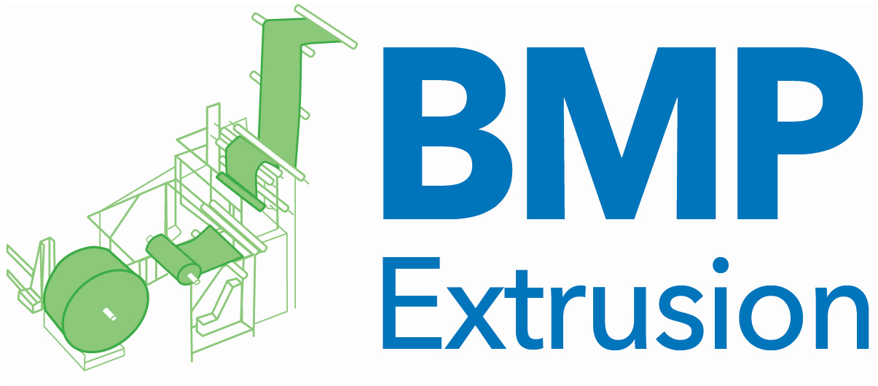
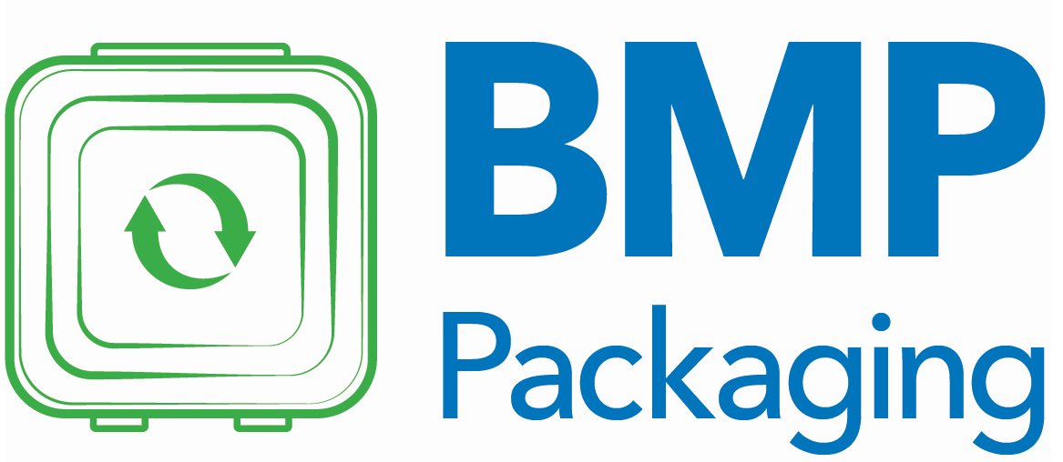
We have a lot of ways to make a difference
With a diverse portfolio of companies committed to sustainability, our products add value and continue to develop the growing circular economy in Canada while achieving reductions in waste, carbon, & energy use.
Manufacturing of Private label, branded and co-manufactured bottled water
Efficiently capturing recyclable material and transforming them into new rPET bottles and other plastics in a continuous closed loop
Brand new, state of the art, plastic extrusion and film printing facility
Development of rPET Thermoform packaging
Creating beautiful, eco-friendly outdoor furniture with recycled plastic caps processed at BMP Recycling
Growing high quality, organic grains and maple syrup on over 3,500 acres of farmland
Revolutionary line of fully compostable products
For more information on Ice River: https://youtu.be/xM78-rHXU5U

Slide 5
Revolutionizing the future of plastic

Slide 6
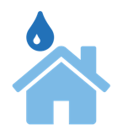
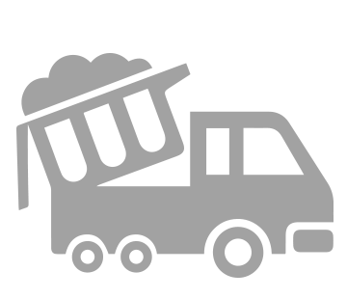
IMPACT Of ICE RIVER 100% rPET BOTTLES VS VIRGIN PLASTIC SINCE WE STARTED RECYCLING
Emission Savings
78%
Energy
Emissions
Water
Waste
savings
avoided
savings
diverted
Powering 1,049
Supermarkets for 1 year
2,622,790,540 kWh
4,174,317
Trees Planted
162,798,354 kg C02e
1,687,838
Daily Household Consumption
1,694,589,346 Litres
20,399
Waste Trucks diverted from Landfill
425,000,000 Lbs
Source: https://greenstory.ca/

Slide 7
Ice river springs differentiators
Ice River Springs facts:
We are the first beverage company in North America to operate its own recycling facility in a closed loop: from The Blue Box (curbside collection), to recycled bottle manufacturing, to fresh natural spring water products…and back again.
All our bottles are made with 100% recycled PET which has the lowest carbon footprint when compared to other plastics, aluminum, glass, and corrugate packaging.
Our water bottling facilities are proudly zero-waste-to landfill
Our green water bottle keeps an additional 5 million pounds of plastic out of landfill each year.
Our focus is always on function over esthetics. Our bottle is different than all others on the market because we use less plastic.
Adds value to the circular economy
We are members of The Blue Box Transition Working Group striving for growth in the circular economy.
If Ice River educates consumers and industry groups on packaging design & recyclability, in order for producers to change, consumers will need to accept change as well.
Design should be for function and end of life, not esthetics
Ice River Green Bottle Co. – took 3 years to convince people it was ok to drink from a green bottle
Laundry Detergent – clear instead of orange
Brand colours – Vivid Blue, red, green, etc – use the natural colour of the plastic instead
Coffee cups – Why must it be red? White works just as well

